Slide 1
Chapter 8
Switching
Copyright © The McGraw-Hill Companies, Inc. Permission required for reproduction or display.

Slide 2
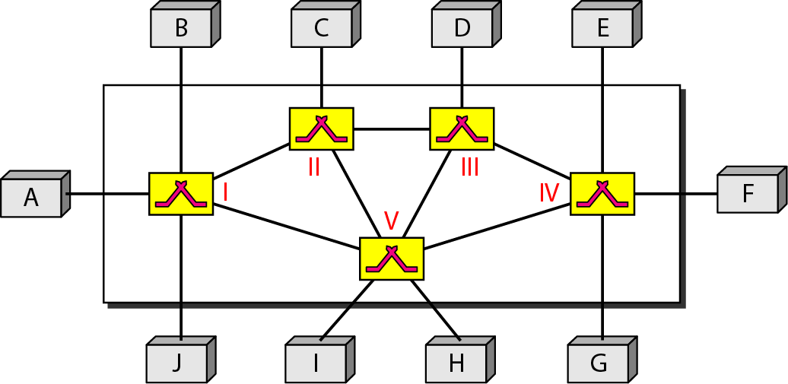
Figure 8.1 Switched network

Slide 3
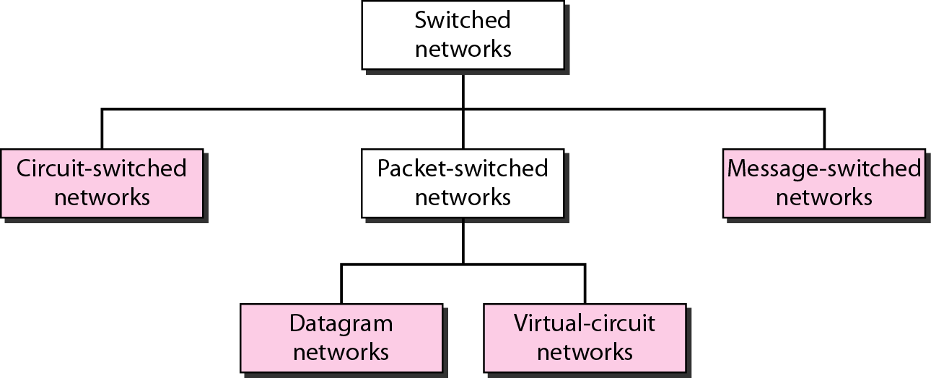
Figure 8.2 Taxonomy of switched networks

Slide 4
8-1 CIRCUIT-SWITCHED NETWORKS
A circuit-switched network consists of a set of switches connected by physical links. A connection between two stations is a dedicated path made of one or more links. However, each connection uses only one dedicated channel on each link. Each link is normally divided into n channels by using FDM or TDM.
Topics discussed in this section:
Three Phases Efficiency Delay
Circuit-Switched Technology in Telephone Networks

Slide 5

Note
In circuit switching, the resources need to be reserved during the setup phase; the resources remain dedicated for the entire duration of data transfer until the teardown phase.

Slide 6
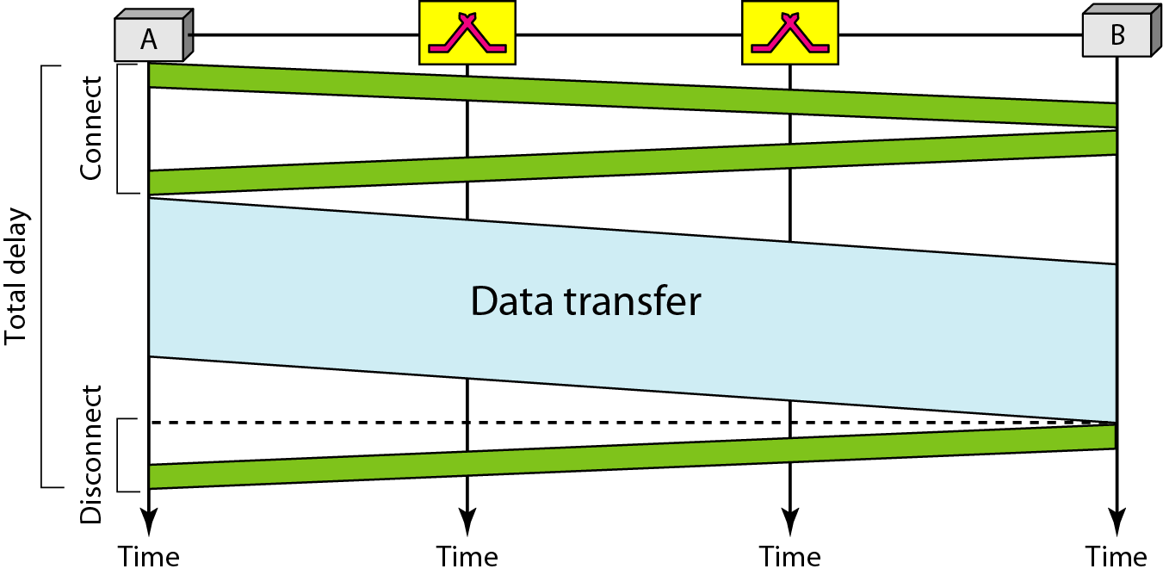
Figure 8.6 Delay in a circuit-switched network

Slide 7
A path in a digital circuit-switched network has a data rate of 1 Mbps. The exchange of 1000 bits is required for the setup and teardown phases. The distance between two parties is 3000 km. Answer the following questions if the propagation speed is 2 × 10⁸ m/s:
a. What is the total delay if 1000 bits of data are exchanged during the data transfer phase?
b. What is the total delay if 100,000 bits of data are exchanged during the data transfer phase?
c. What is the total delay if 1,000,000 bits of data are exchanged during the data transfer phase?

Slide 8
Note
Switching at the physical layer in the traditional telephone network uses
the circuit-switching approach.

Slide 9
8-2 DATAGRAM NETWORKS
In data communications, we need to send messages from one end system to another. If the message is going to pass through a packet-switched network, it needs to be divided into packets of fixed or variable size. The size of the packet is determined by the network and the governing protocol.
Topics discussed in this section:
Routing Table Efficiency Delay
Datagram Networks in the Internet

Slide 10
Two Basic Forms of Packet Switching
Packets handled in two ways
Datagram (covered in this section)
Virtual circuit (covered in the next section)

Slide 11
Datagram
Each packet treated independently
Packets can take any practical route
Packets may arrive out of order
Packets may get lost or delayed
Up to receiver to re-order packets and recover from missing packets

Slide 12
Virtual Circuit
Preplanned route established before any packets sent
Call request and call accept packets establish connection (handshake)
Each packet contains a virtual circuit identifier instead of destination address
No routing decisions required for each packet
Clear request to drop circuit
Not a dedicated

Slide 13
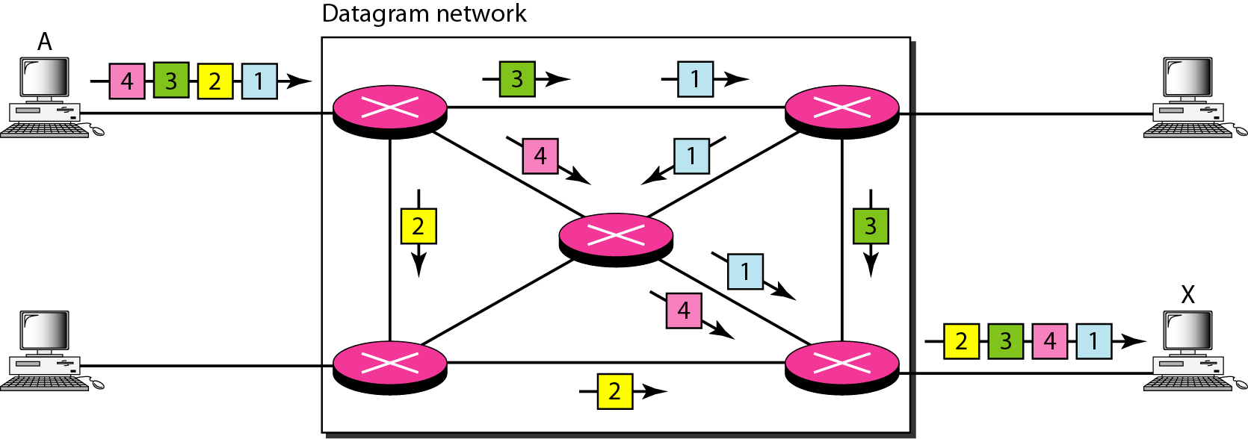
Figure 8.7 A datagram network with four switches (routers)

Slide 14
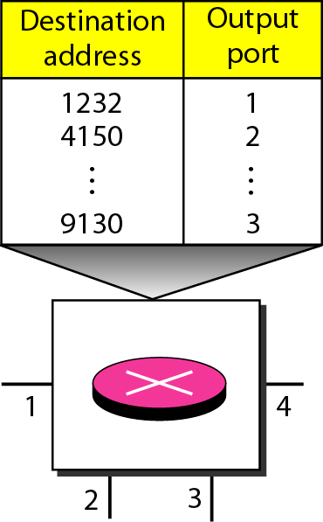
Figure 8.8 Routing table in a datagram network

Slide 15
Note
A switch in a datagram network uses a routing table that is based on the destination address.

Slide 16
Note
The destination address in the header of a packet in a datagram network
remains the same during the entire journey of the packet.

Slide 17
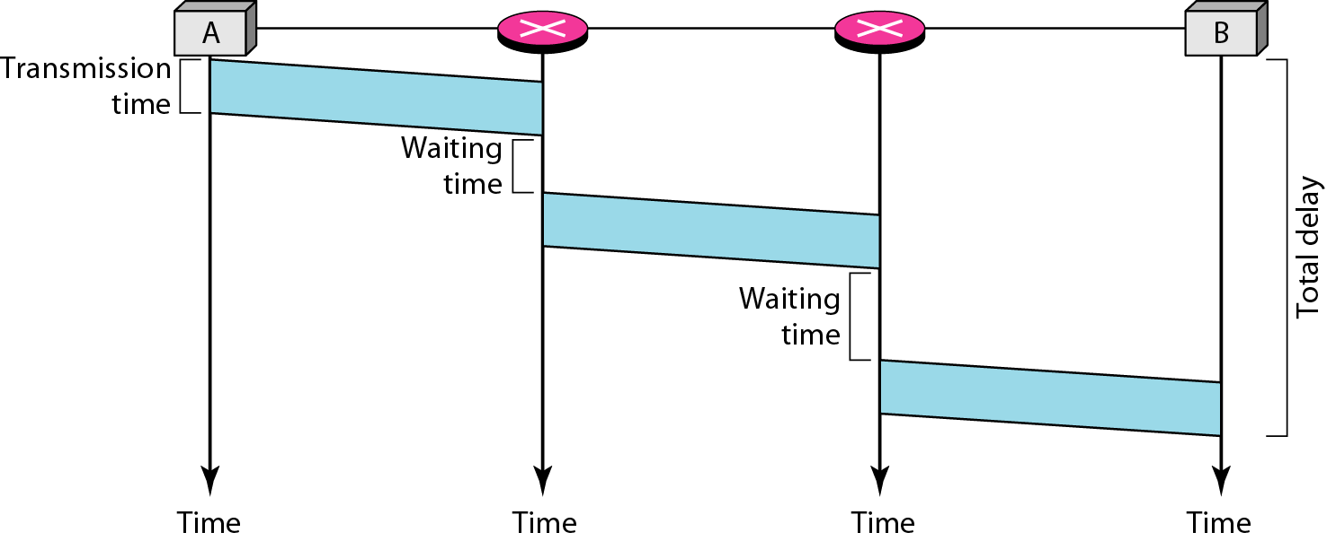
Figure 8.9 Delay in a datagram network
Total delay =3T + 3t + WI + W2
W1 and W2 are the switch waiting time

Slide 18
Five equal-size datagrams belonging to the same message leave for the destination one after another. However, they travel through different paths as shown in the following table
We assume that the delay for each switch (including waiting and processing) is 3, 10, 20, 7, and 20 ms respectively. Assuming that the propagation speed is 2×10⁸ m/s, find the order the datagrams arrive at the destination and the delay for each. Ignore any other delays in transmission.

Slide 19
Note
Switching in the Internet is done by using the datagram approach to packet switching at the network layer.

Slide 20
8-3 VIRTUAL-CIRCUIT NETWORKS
A virtual-circuit network is a cross between a circuit-switched network and a datagram network. It has some characteristics of both.
Topics discussed in this section:
Addressing Three Phases
Efficiency Delay
Circuit-Switched Technology in WANs

Slide 21
As in a circuit-switched network, there are setup and teardown phases in addition to the data transfer phase.
Resources can be allocated during the setup phase, as in a circuit-switched network.
As in a datagram network, data are packetized and each packet carries an address in the header.
As in a circuit-switched network, all packets follow the same path established during the connection.

Slide 22
A virtual-circuit network is normally implemented in the data link layer.
While circuit-switched network is implemented in the physical layer
and a datagram network in the network layer.

Slide 23
Addressing
Global Addressing : An address that can be unique in the scope of the network
Virtual Circuit Identifier (VCI): The identifier that is actually used for data transfer is called the virtual-circuit identifier.
It is used by a frame between two switches. When a frame arrives at a switch, it has a VCI; when it leaves, it has a different VCl.

Slide 24
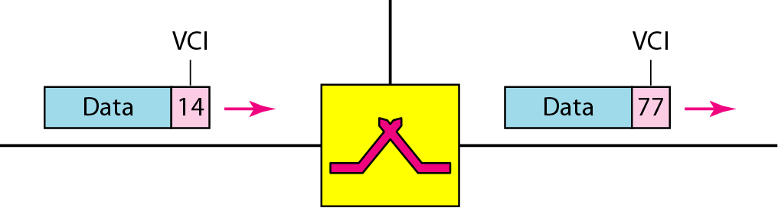
Figure 8.11 Virtual-circuit identifier

Slide 25
Phases
Setup Phase, Teardown and Data transfer Phase
In the setup phase, the source and destination use their global addresses to help switches make table entries for the connection.
In the teardown phase, the source and destination inform the switches to delete the corresponding entry.
Data transfer occurs between these two phases.

Slide 26
Data Transfer Phase
To transfer a frame from a source to its destination, all switches need to have a table entry for the virtual circuit.
The table, in its simplest form, has four columns.
This means that the switch holds four pieces of information for each virtual circuit that is already set up.
We show later how the switches make their table entries, but for the moment we assume that each switch has a table with entries for all active virtual circuits.

Slide 27
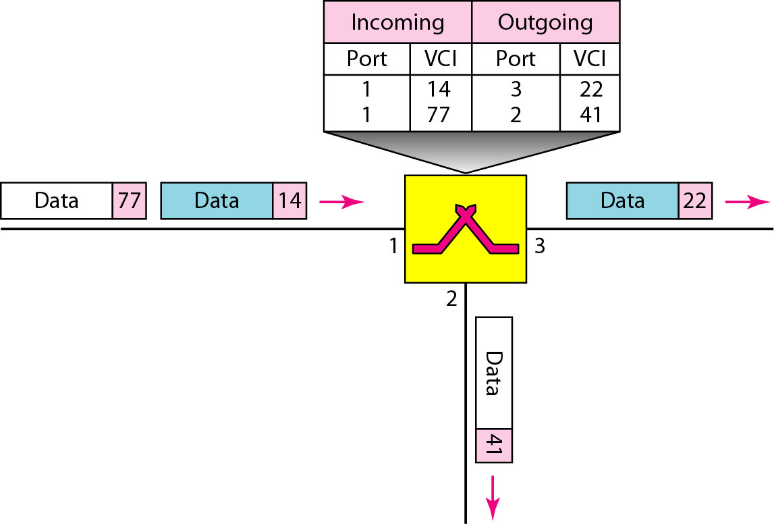
Figure 8.12 Switch and tables in a virtual-circuit network

Slide 28
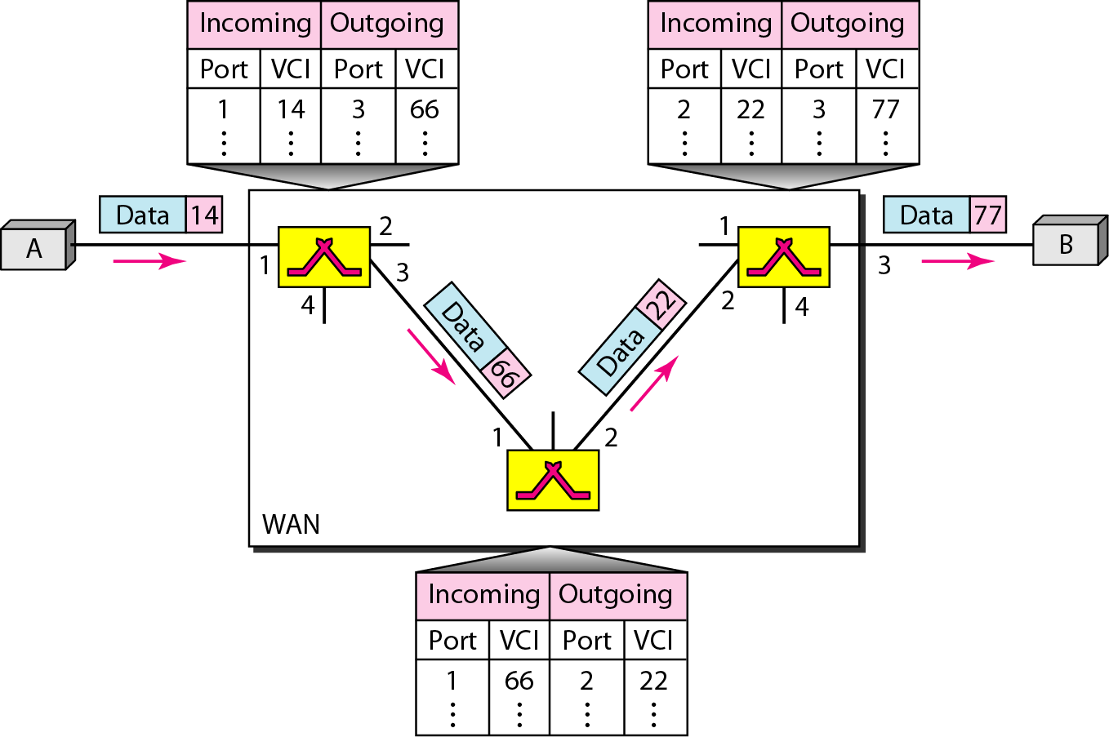
Figure 8.13 Source-to-destination data transfer in a virtual-circuit network
Figure 8.13 shows how a frame from source A reaches destination B and how its
VCI changes during the trip. Each switch changes the VCI and routes the frame.

Slide 29
Setup phase
Suppose source A needs to create a virtual circuit to B.
Two steps are required:
the setup request
the acknowledgment

Slide 30
a. Source A sends a setup frame to switch 1.
b. Switch 1 receives the setup request frame. It knows that a frame going from A to B goes out through port 3.
The switch creates an entry in its table for this virtual circuit, but it is only able to fill three of the four columns. The switch assigns the incoming port (1) and chooses an available incoming VCI (14) and the outgoing port (3).
It does not yet know the outgoing VCI, which will be found during the acknowledgment step. The switch then forwards the frame through port 3 to switch 2.
c. Switch 2 receives the setup request frame. The same events happen here as at switch 1; three columns of the table are completed: in this case, incoming port (l), incoming VCI (66), and outgoing port (2).

Slide 31
d. Switch 3 receives the setup request frame. Again, three columns are completed: incoming port (2), incoming VCI (22), and outgoing port (3).
e. Destination B receives the setup frame, and if it is ready to receive frames from A, it assigns a VCI to the incoming frames that come from A, in this case 77. This
VCI lets the destination know that the frames come from A, and not other sources.

Slide 32
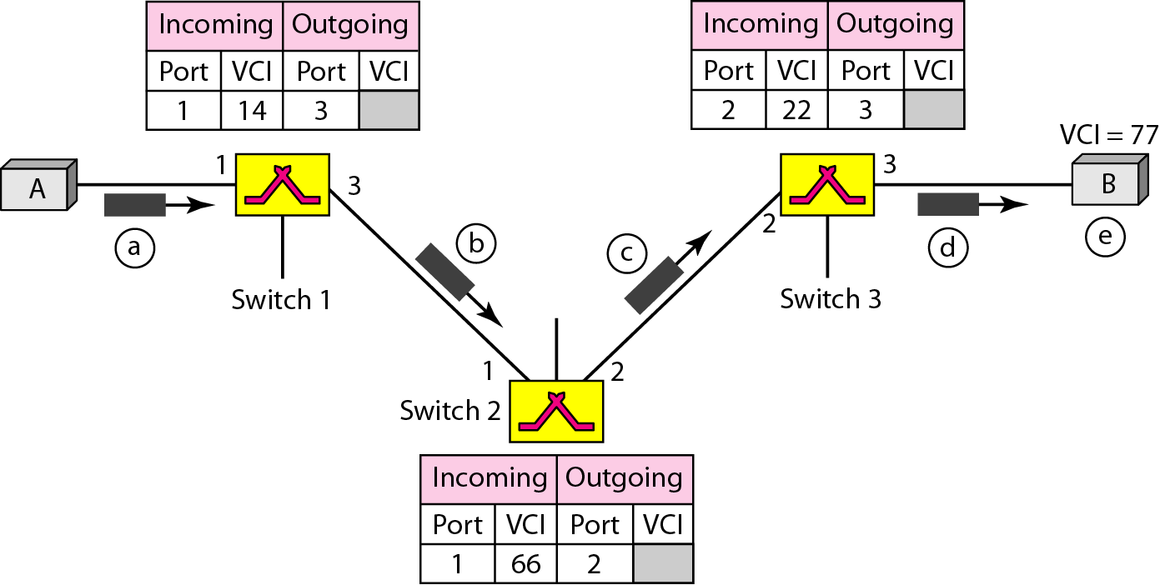
Figure 8.14 Setup request in a virtual-circuit network

Slide 33
Acknowledgment A special frame, called the acknowledgment frame, completes the entries in the switching tables.
a. The destination sends an acknowledgment to switch 3. The acknowledgment carries the global source and destination addresses so the switch knows which entry in the table is to be completed. The frame also carries VCI 77, chosen by the destination as the incoming VCI for frames from A. Switch 3 uses this VCI to complete the outgoing VCI column for this entry.
b. Switch 3 sends an acknowledgment to switch 2 that contains its incoming VCI in the table, chosen in the previous step. Switch 2 uses this as the outgoing VCI in the table.
c. Switch 2 sends an acknowledgment to switch 1 that contains its incoming VCI in the table, chosen in the previous step. Switch 1 uses this as the outgoing VCI in the table.
d. Finally switch 1 sends an acknowledgment to source A that contains its incoming VCI in the table, chosen in the previous step.

Slide 34
e. The source uses this as the outgoing VCI for the data frames to be sent to destination B.
Teardown Phase
In this phase, source A, after sending all frames to B, sends a special frame called a teardown request.
Destination B responds with a teardown confirmation frame.
All switches delete the corresponding entry from their tables.

Slide 35
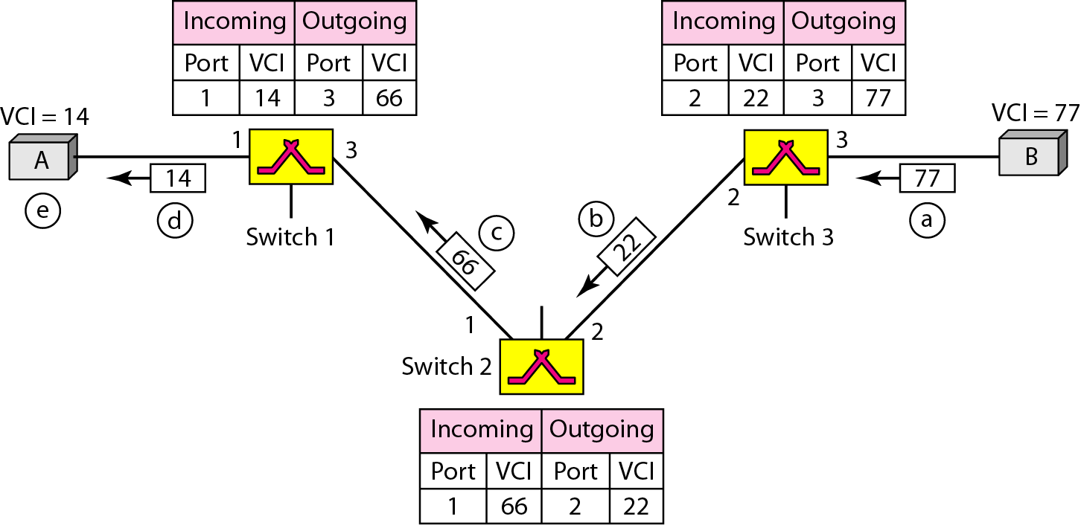
Figure 8.15 Setup acknowledgment in a virtual-circuit network

Slide 36
Note
In virtual-circuit switching, all packets belonging to the same source and destination travel the same path;
but the packets may arrive at the destination with different delays if resource allocation is on demand.

Slide 37
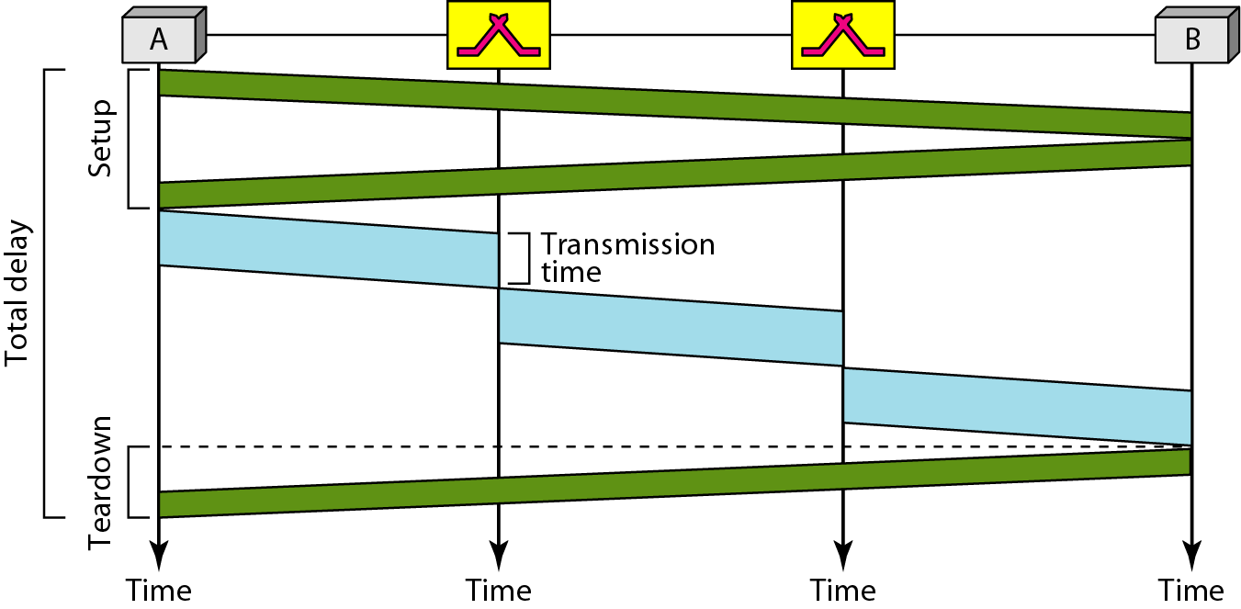
Figure 8.16 Delay in a virtual-circuit network
Total delay = 3T+ 3't + setup delay + teardown delay

